Slide 1

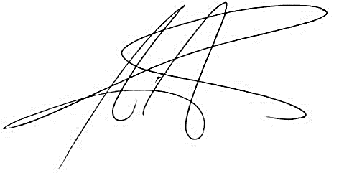
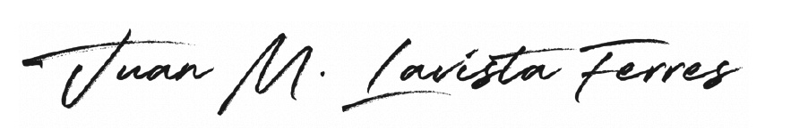
This is to certify that
Sondos Ali
successfully completed the 2024 EY Open Science Data Challenge.
Beatriz Sanz Saiz
EY Global Data & Analytics Leader
Juan Lavista Ferres
AI for Good, Microsoft
VP & Chief Data Scientist
© 2024 EYGM Limited. All Rights Reserved.
Don’t just predict the future. Build a better one.

